Slide 1
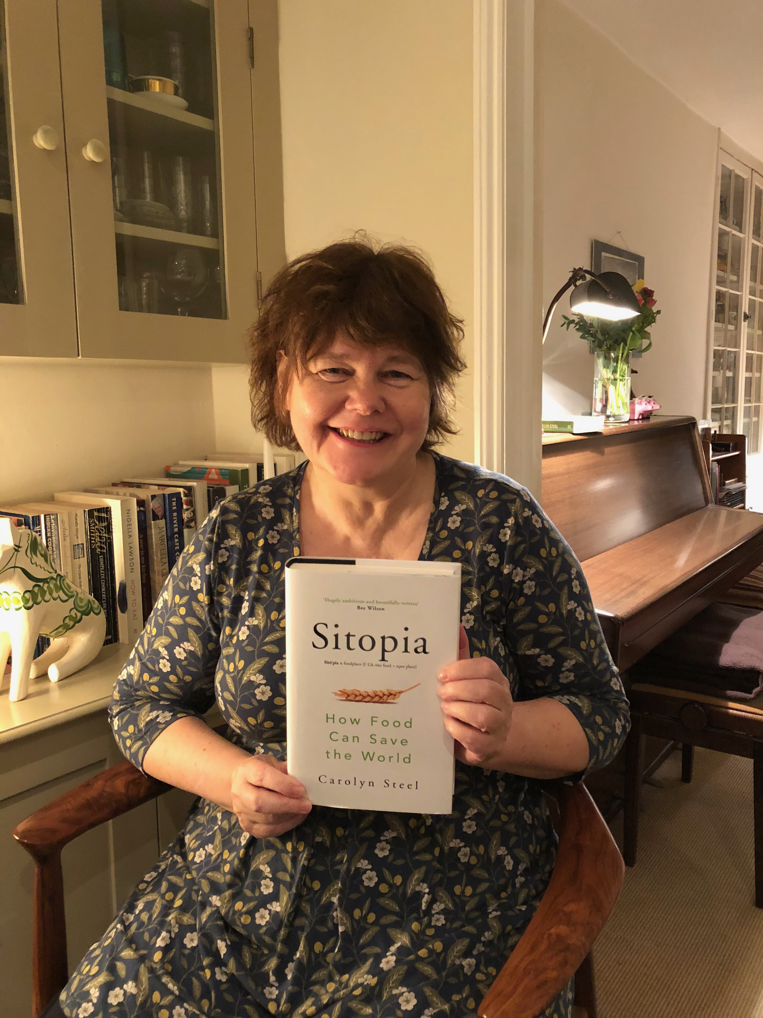
SITOPIA
How Food Can Save the World

Slide 3
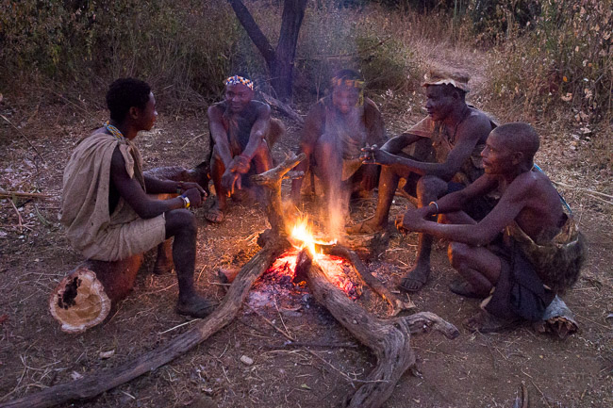
Hadza, Tanzania
How to eat?

Slide 4
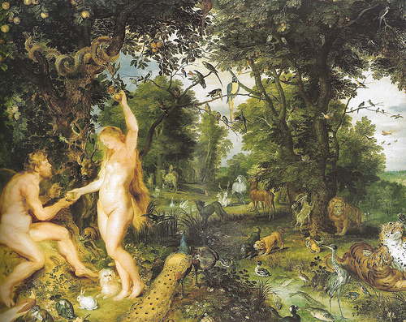
Peter Rubens – Paradise, 1616
How to live?

Slide 5
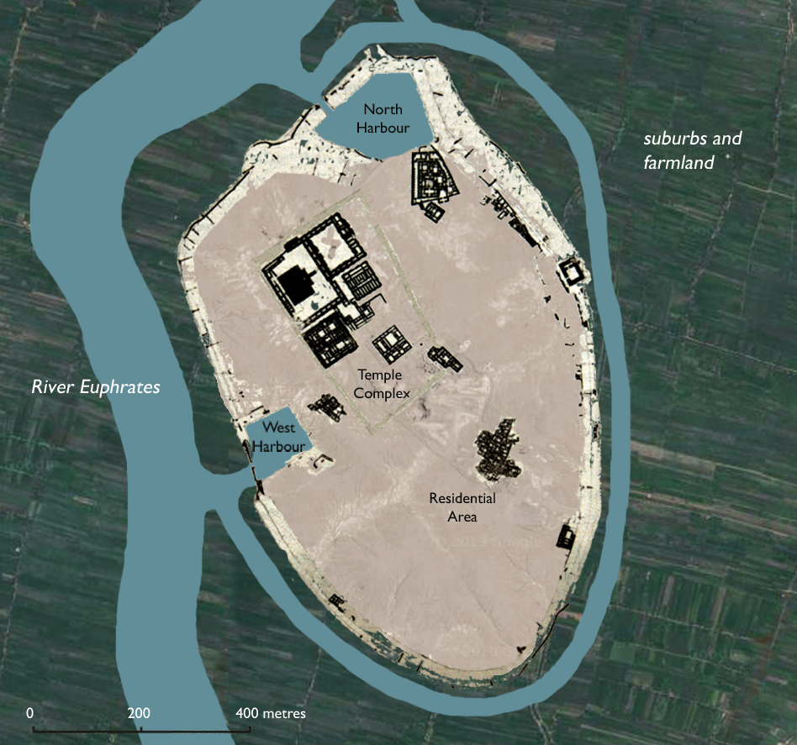
Ur, 2000 BCE
City 1.0

Slide 6
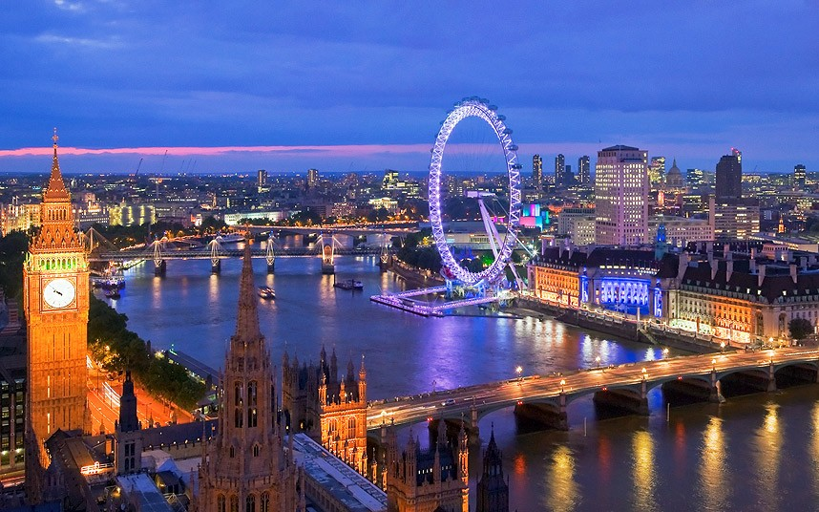
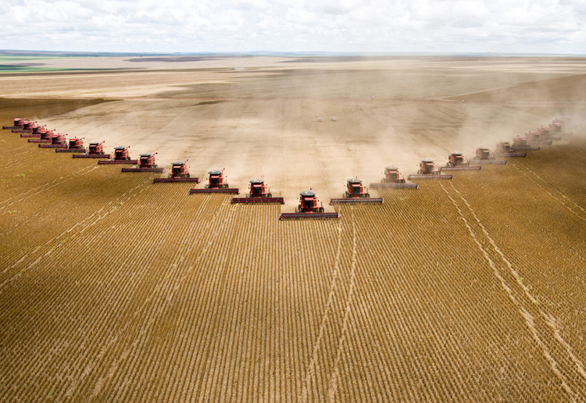
London
Mato Grosso, Brazil
Urban paradox

Slide 7
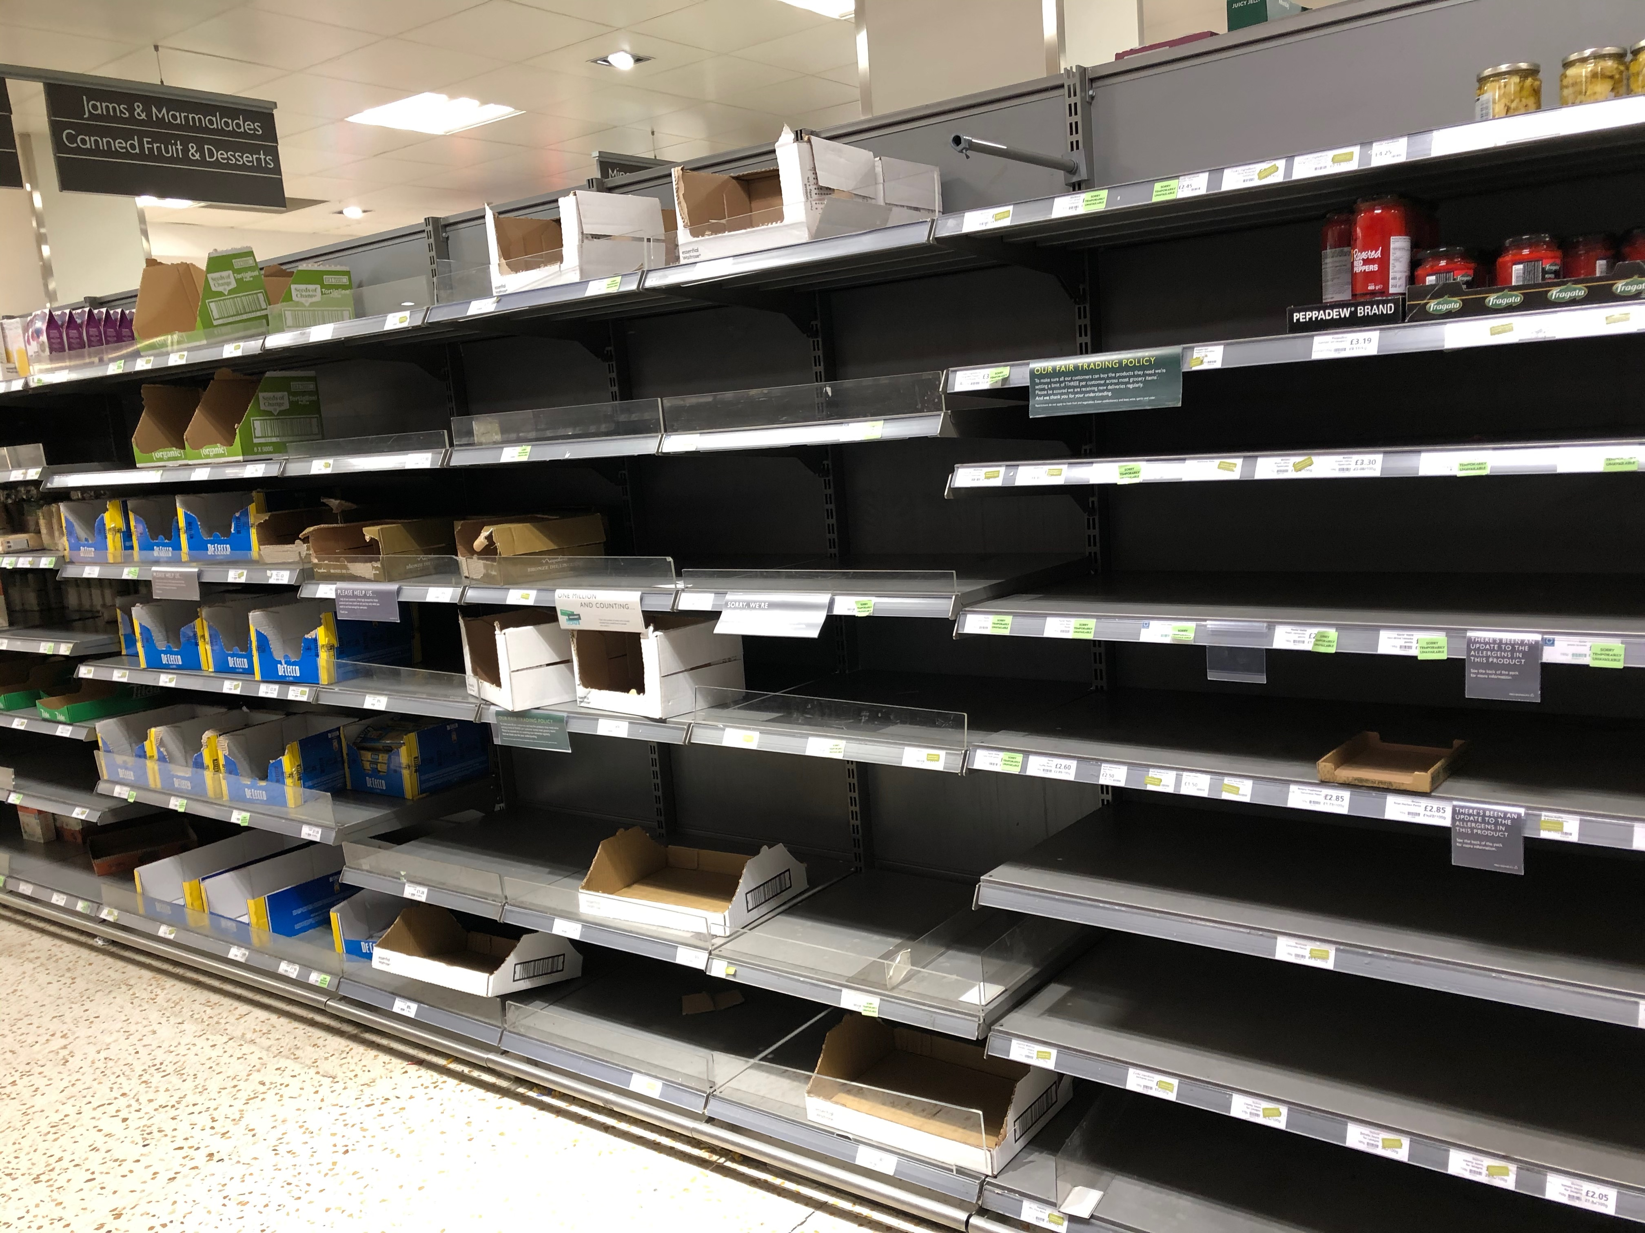
London supermarket, 2020
Shock

Slide 8
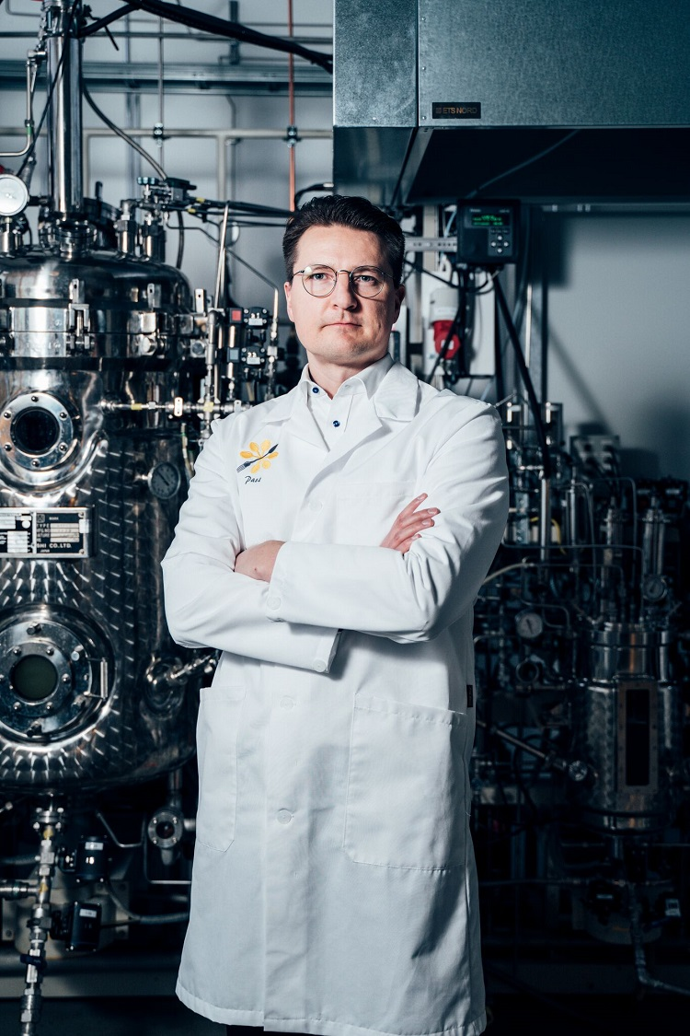
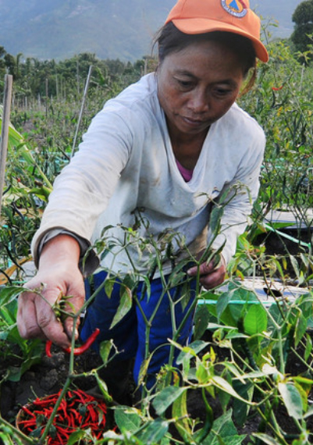
Pasi Vainakka – Solar Foods
Smallholder farmer, Indonesia
Who produces?

Slide 9
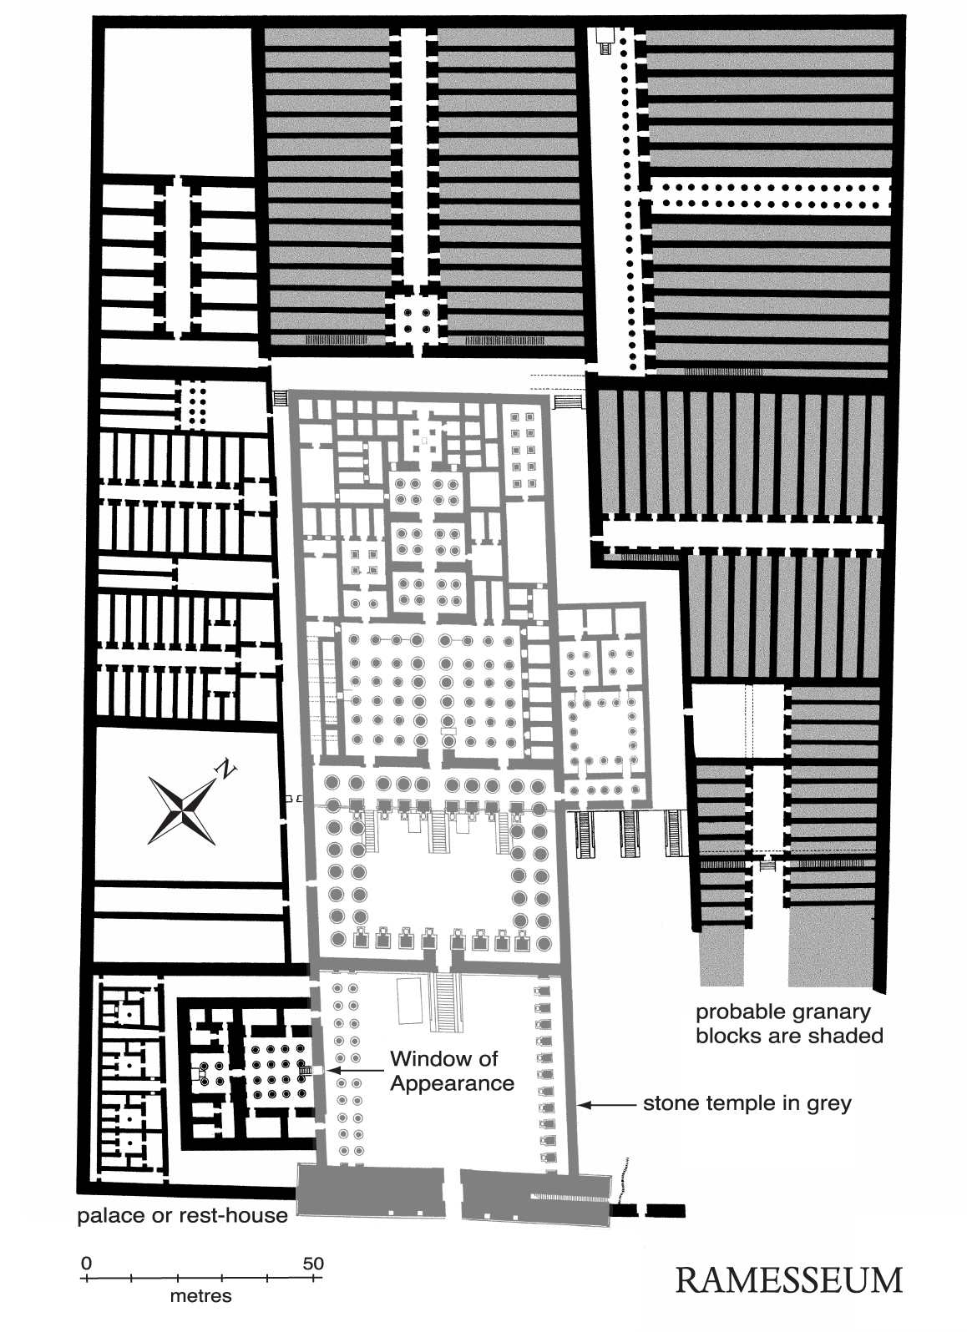
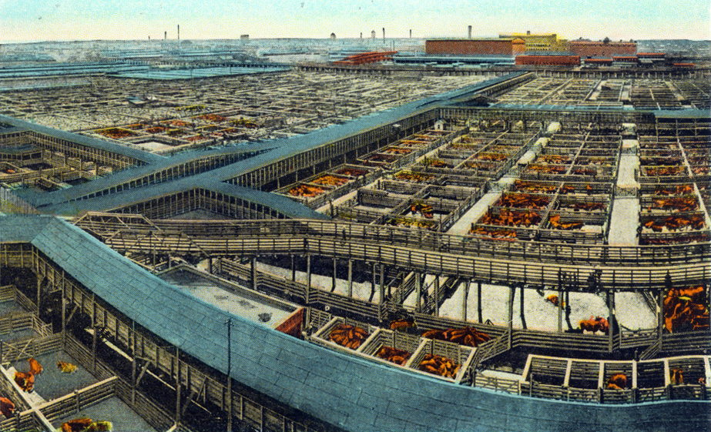
Ramesseum, Thebes, 13thC. BCE
Chicago Union Stockyards, 1880
Who controls?

Slide 10
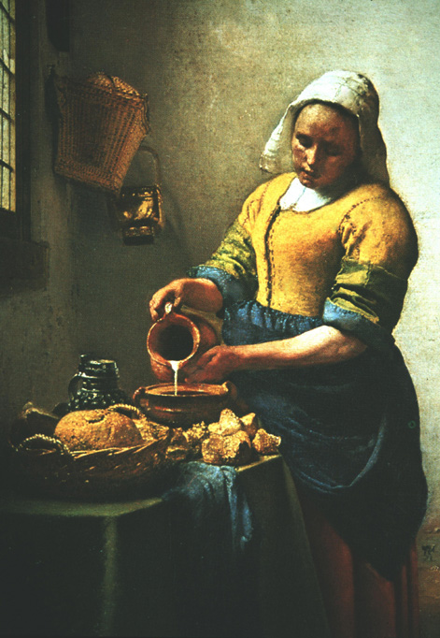
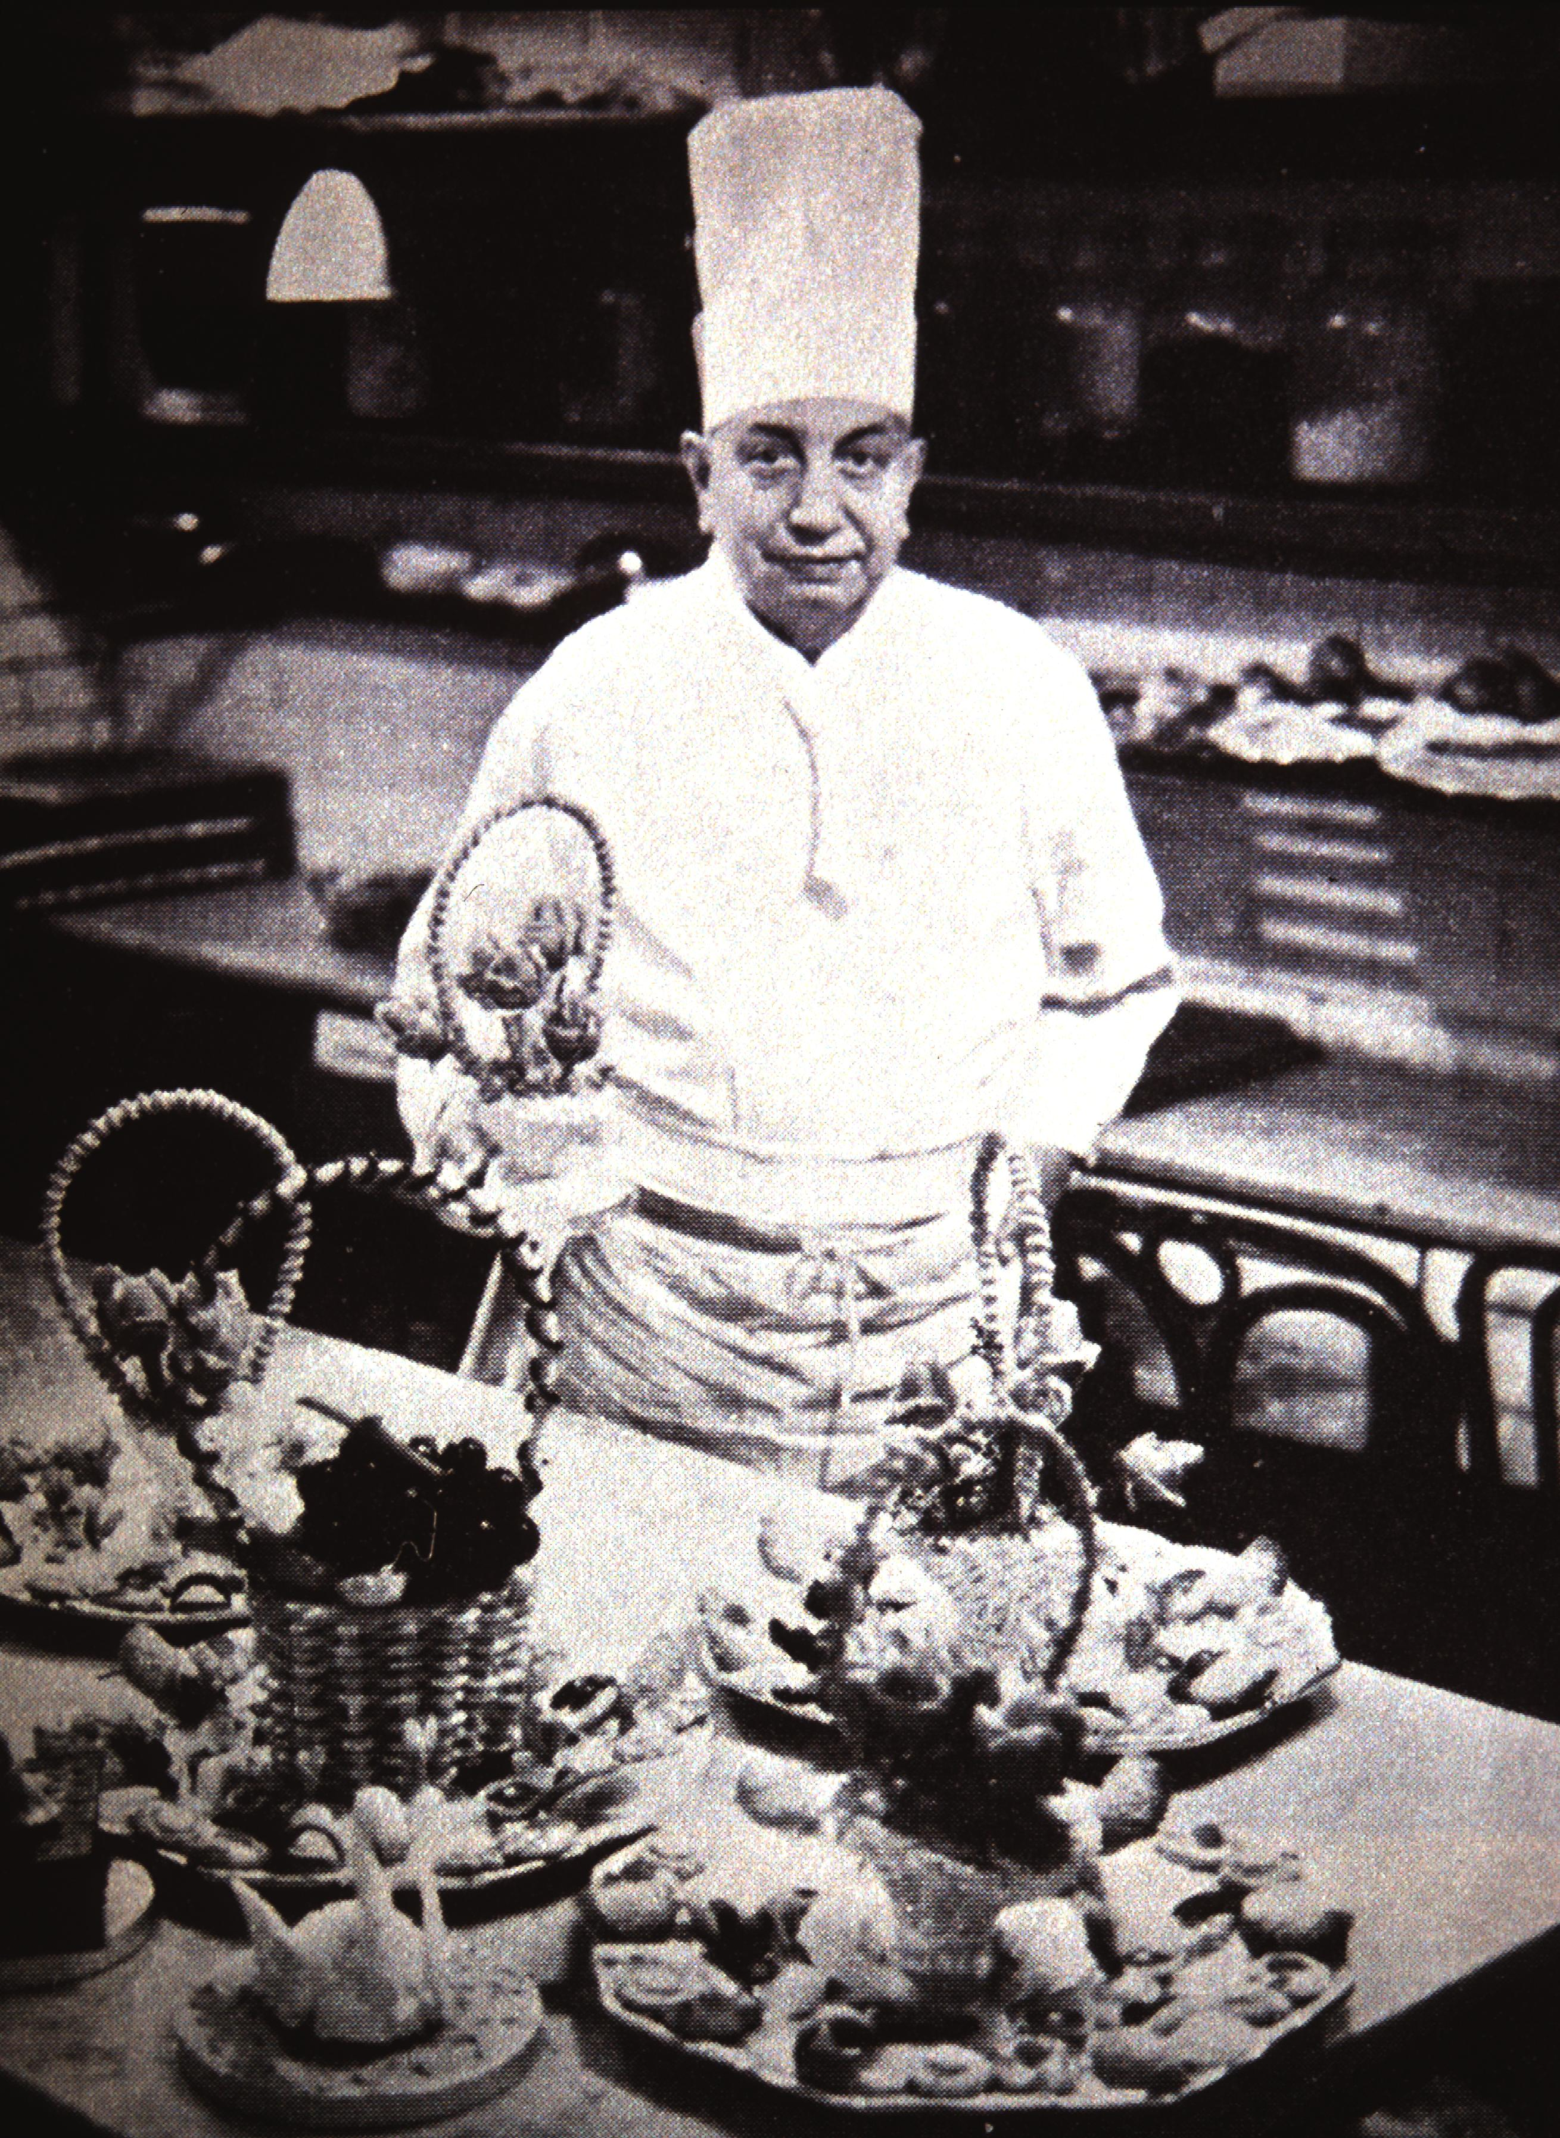
Who cooks?

Slide 11
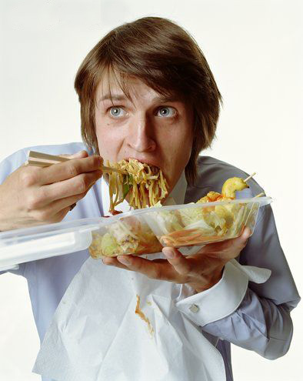
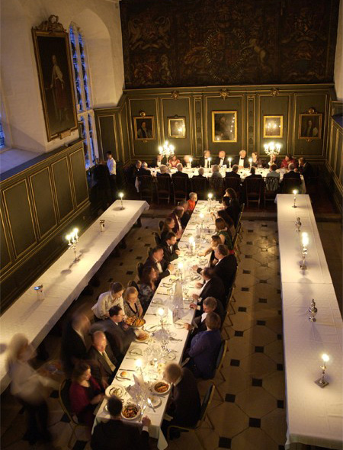
Who eats?

Slide 12
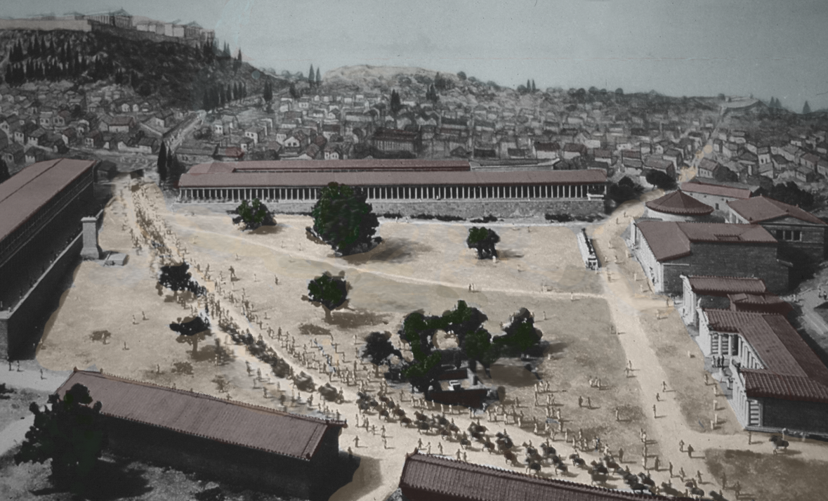
Athenian agora
Public space

Slide 13
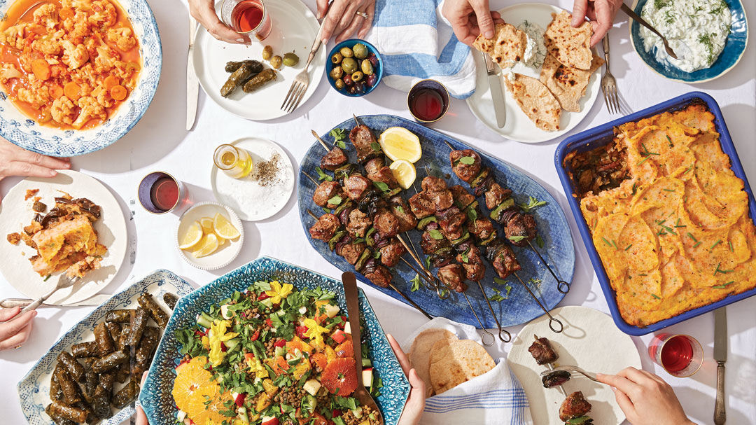
Sitos + opson
Table manners

Slide 14
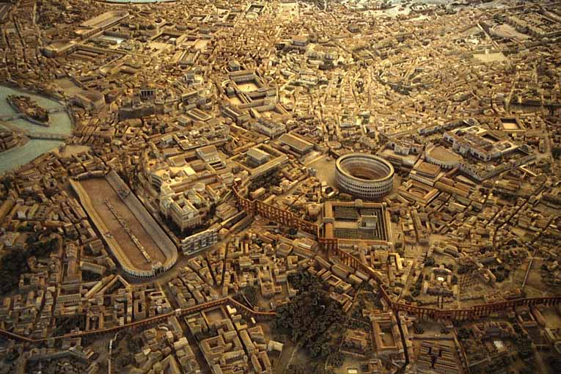
Rome, 300 AD
Metropolis

Slide 15
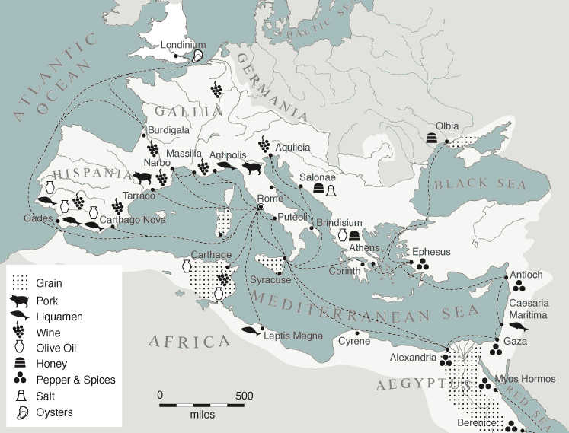
Roman food miles

Slide 16
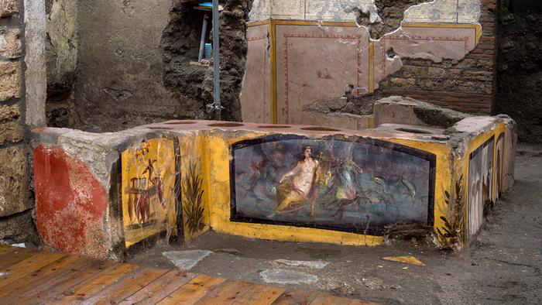
Taberna, Pompeii
Eating out

Slide 17
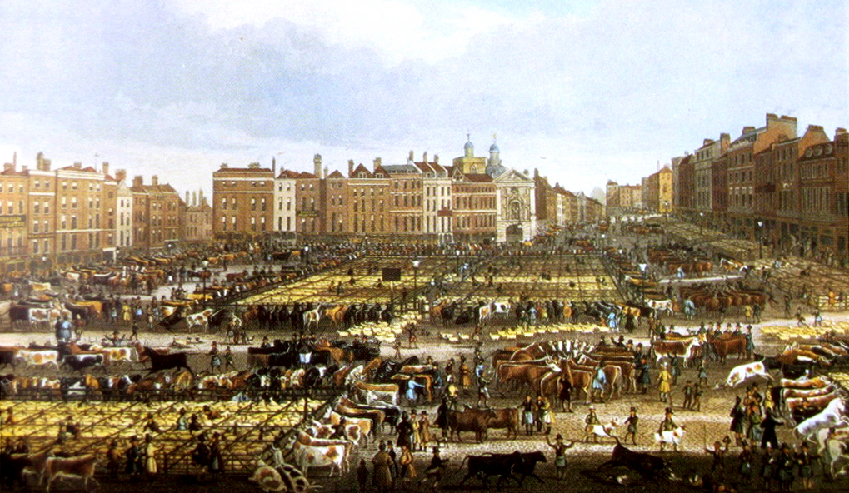
Smithfield Market, 1830
Necessary chaos
Notes:
Meat walking in
imagine city full of food….
when you look at maps like these, two things:
streets tell you how food travelled, and cities full of food.

Slide 18
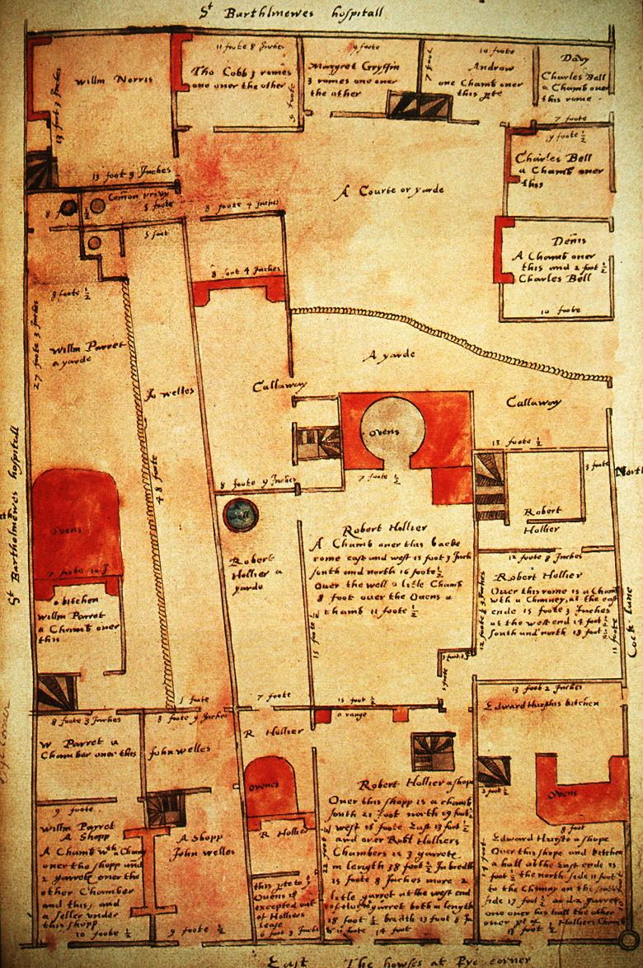
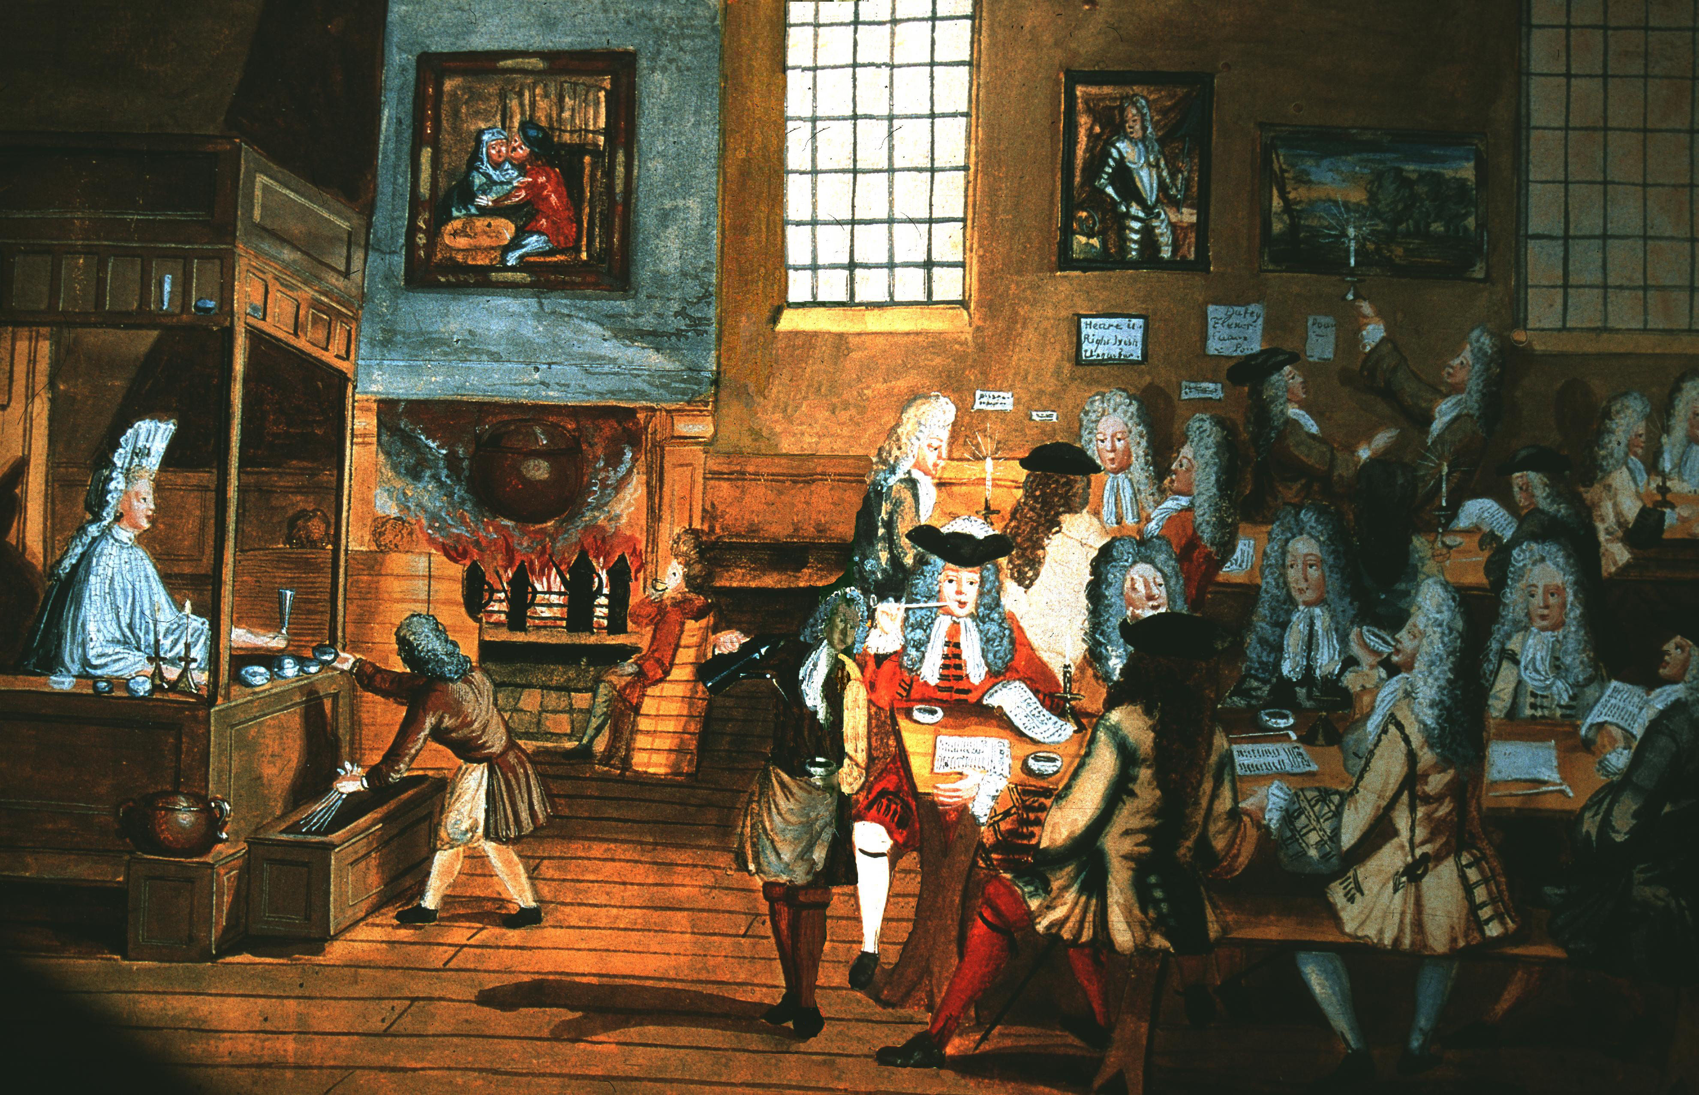
Houses at Pye Corner – Treswell, 1611
London coffee house, 1668
Conviviality

Slide 19
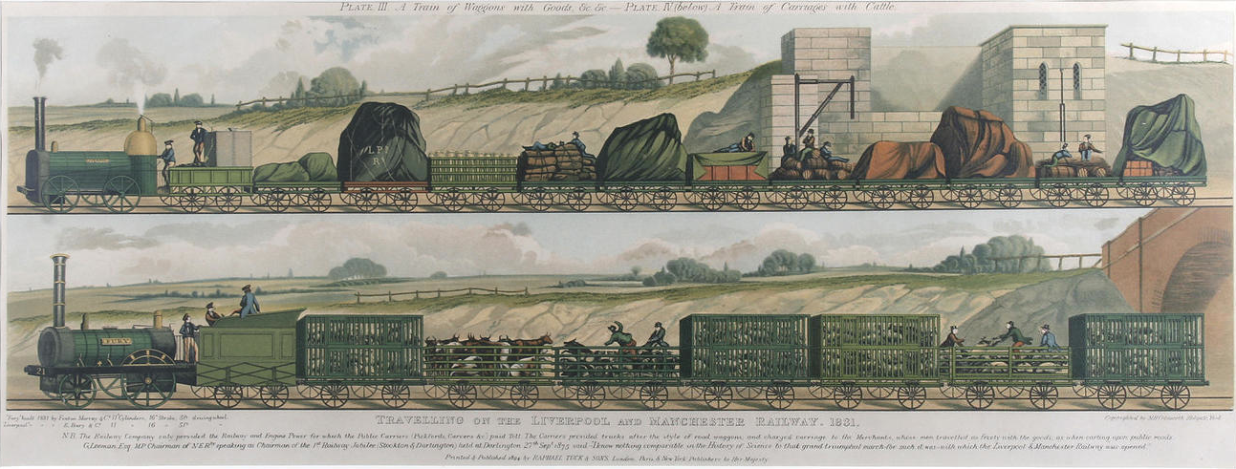
Liverpool to Manchester Railway, 1831
Goodbye geography

Slide 20
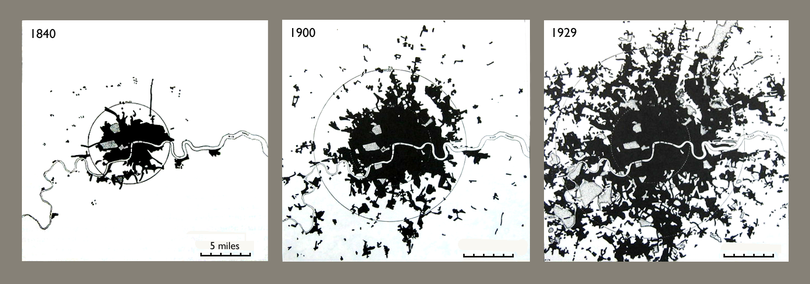
Growth of London 1840-1929
Urban sprawl

Slide 21
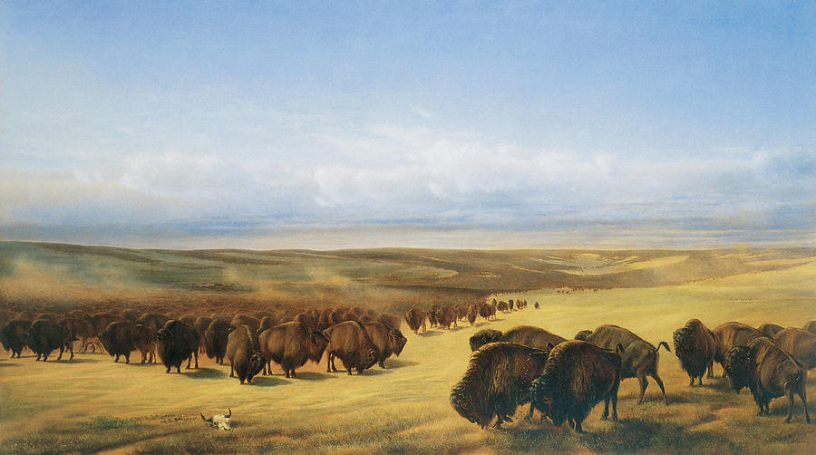
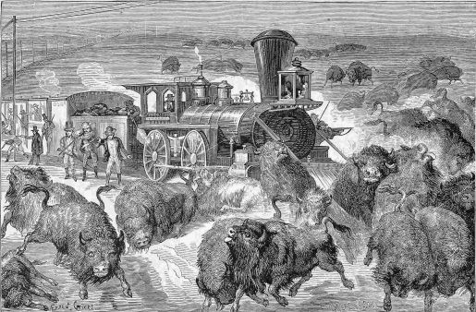
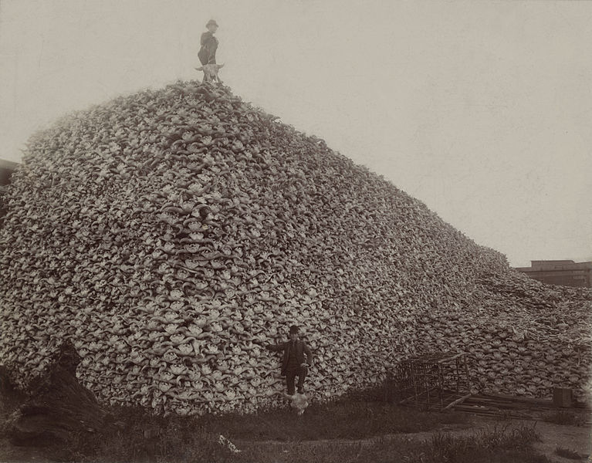
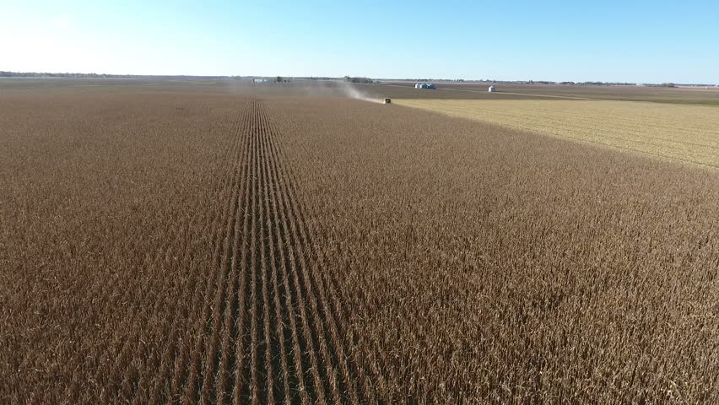
American ‘Great West’
Monoculture

Slide 22
Chicago Union Stockyards, 1880
’Cheap’ meat

Slide 23
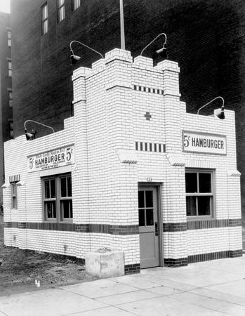
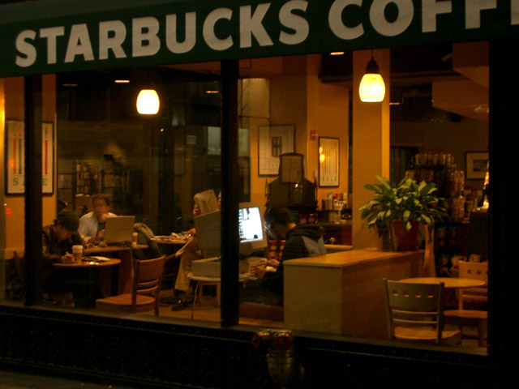
White Castle, Cincinatti 1921
Starbucks today
Anonymity

Slide 24
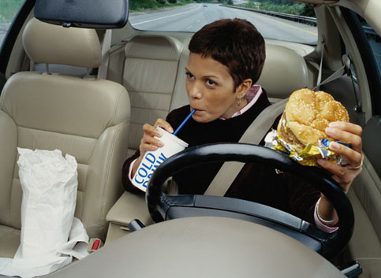
Food as fuel

Slide 25
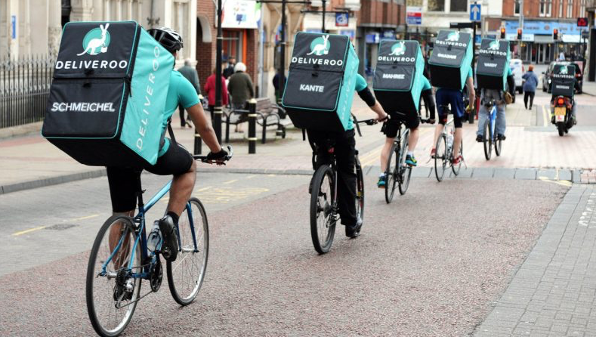
Magic carpet

Slide 26
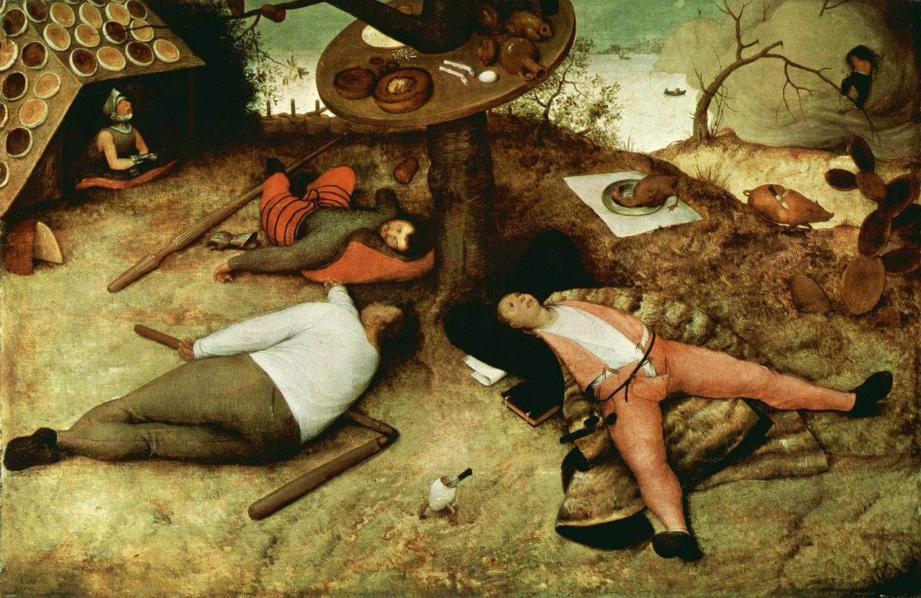
Pieter Breugel – The Land of Cockaigne, 1567
Peasant’s dream

Slide 27
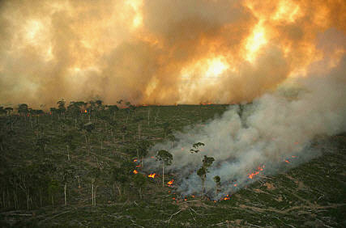

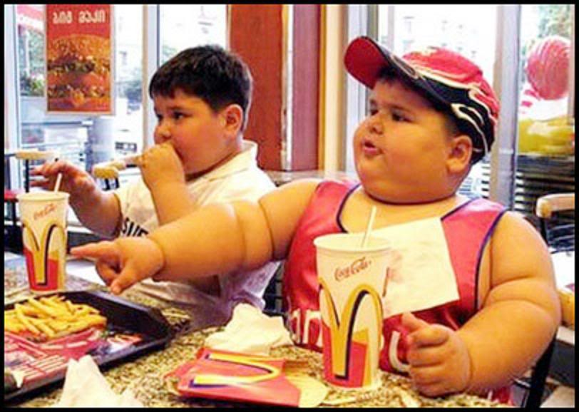
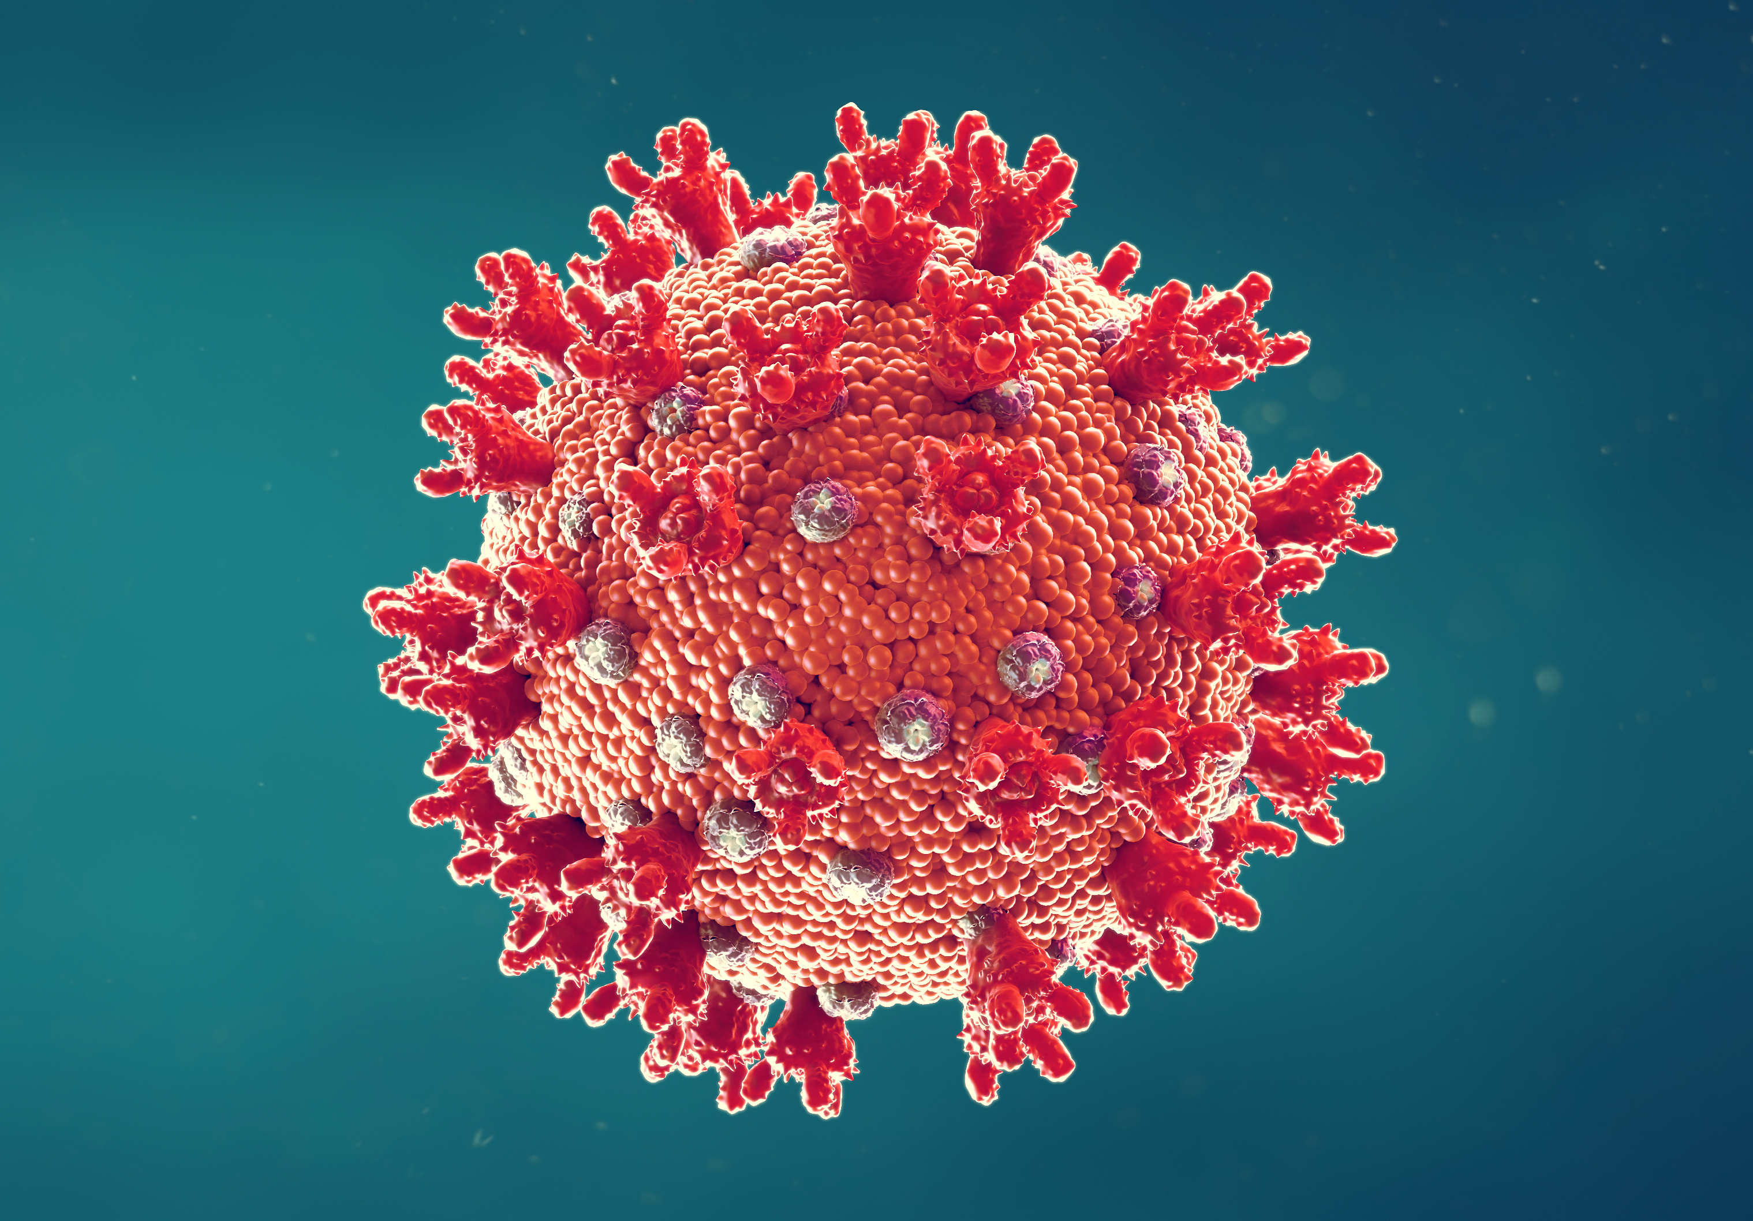
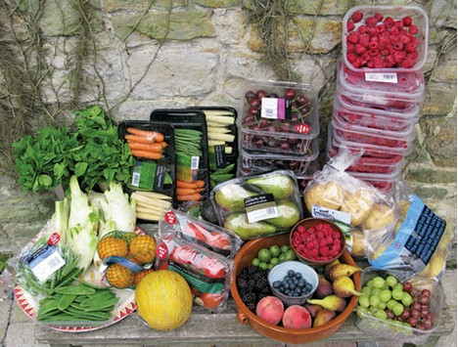
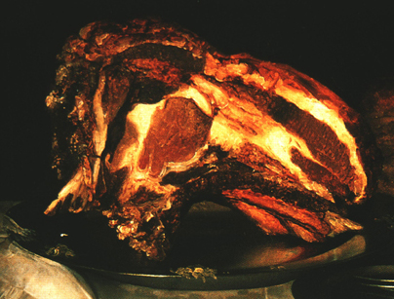
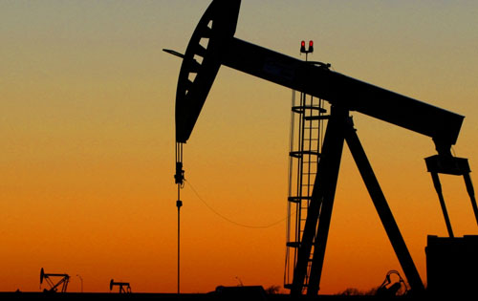
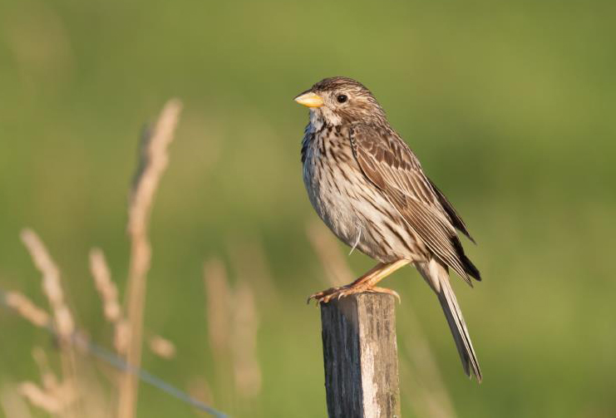
1/3 lost or degraded
30% food-related
70% in farming
2 billion
Covid
50% wasted
1/3 harvest
10 cals for 1
55 % decline
Externalities

Slide 28
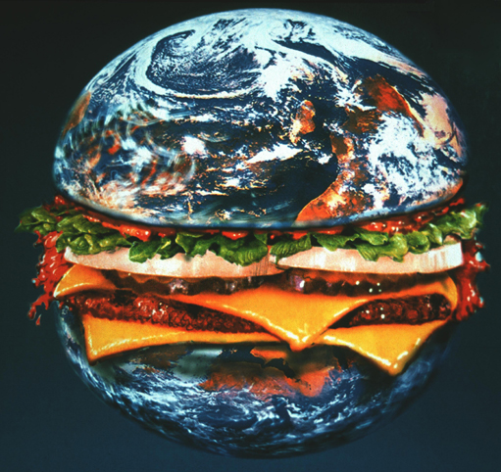
Credit: Steve Crisp
McGlobe

Slide 29
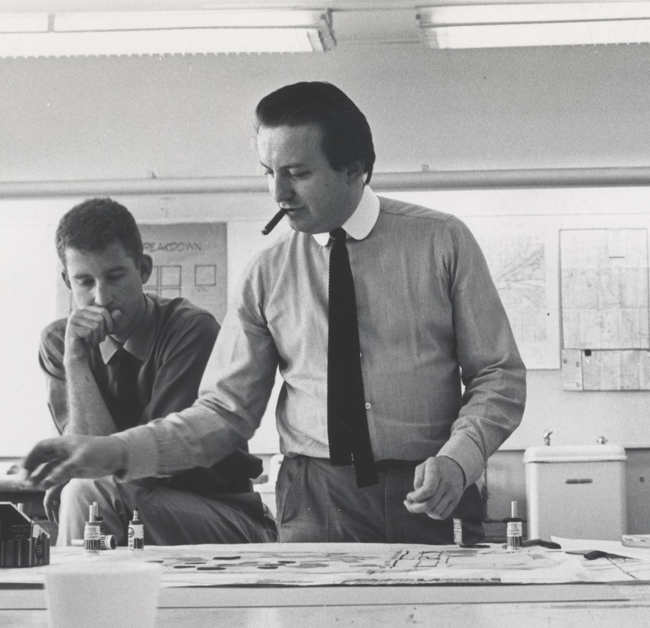
Technology is the answer, but what was the question?
Cedric Price
Rethink

Slide 30
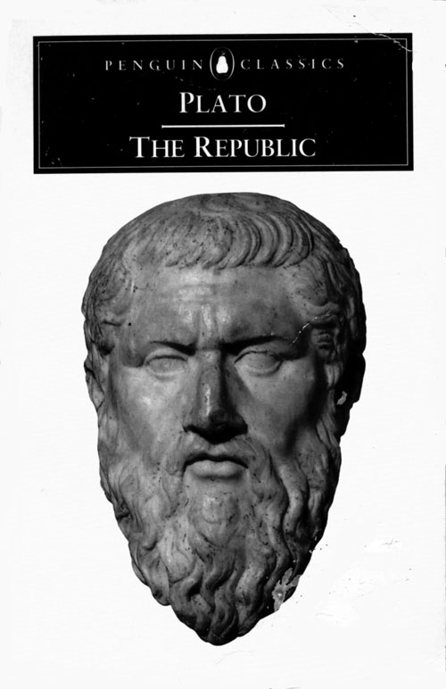
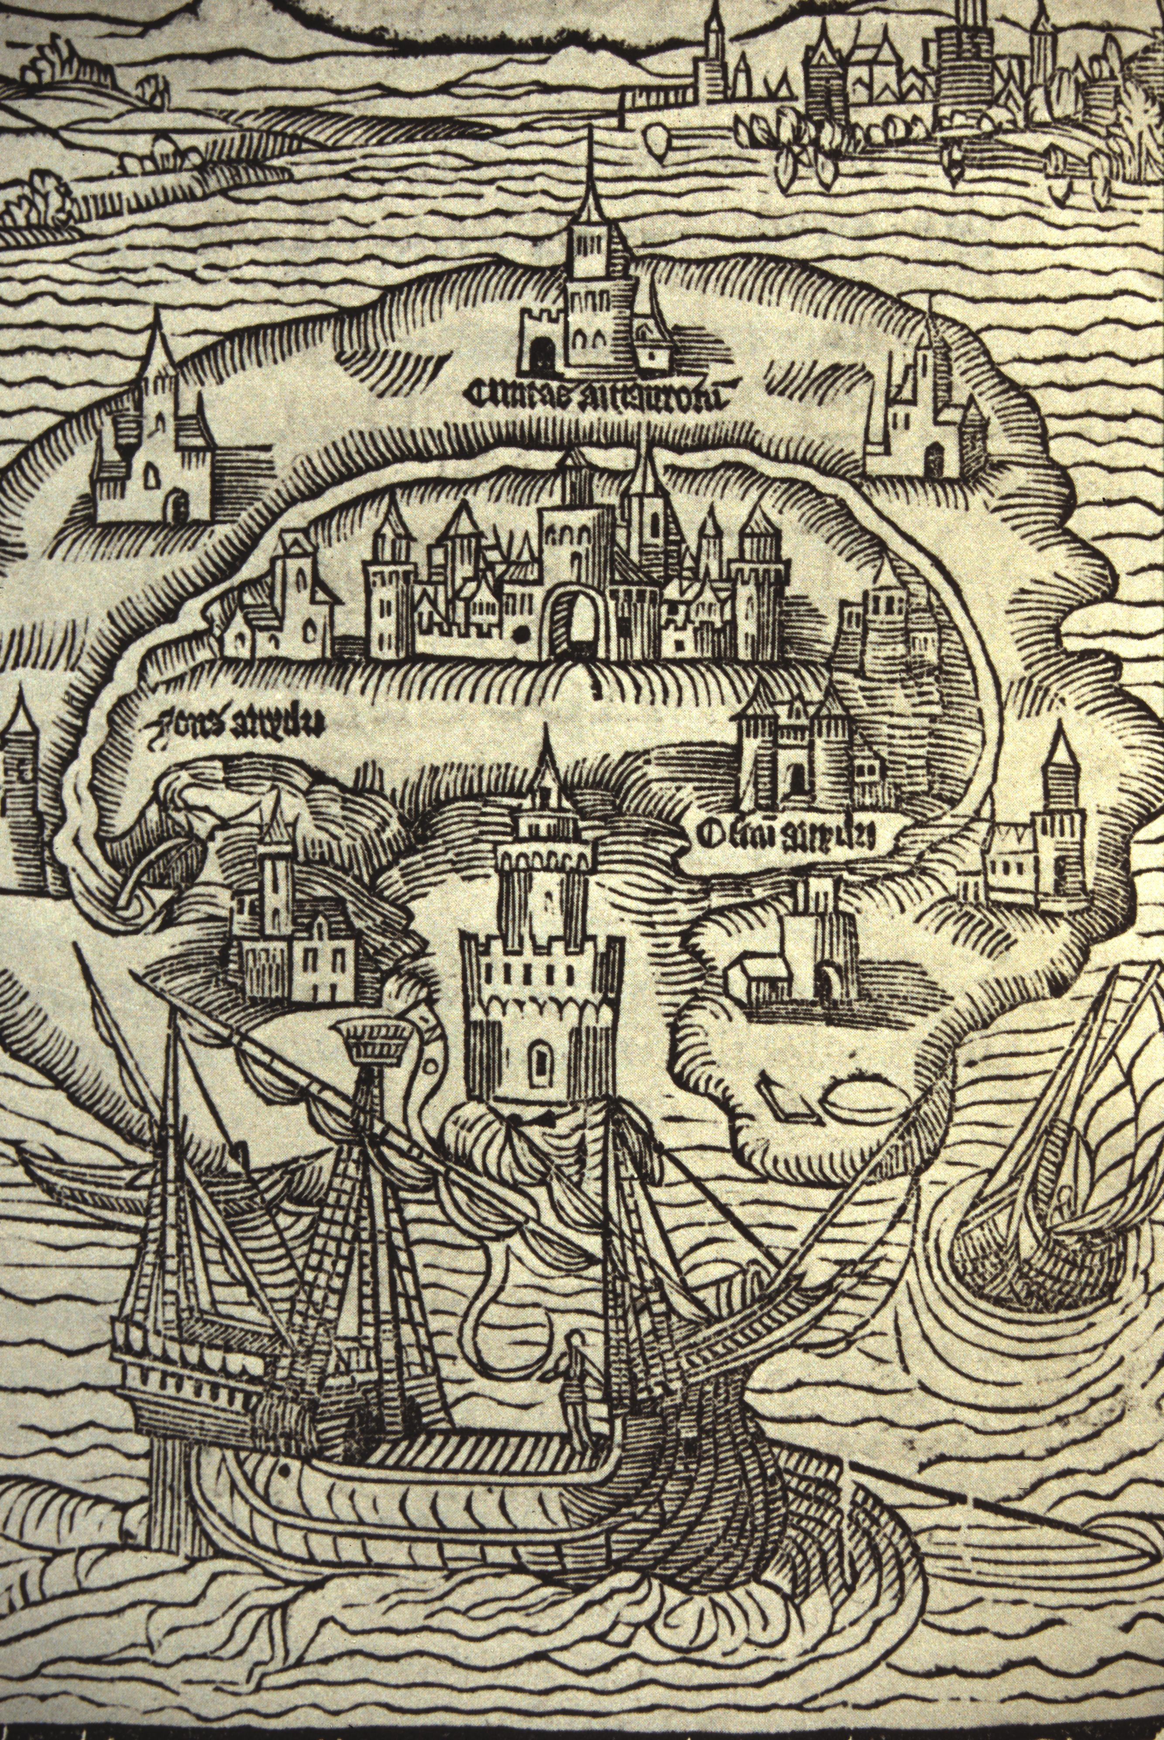
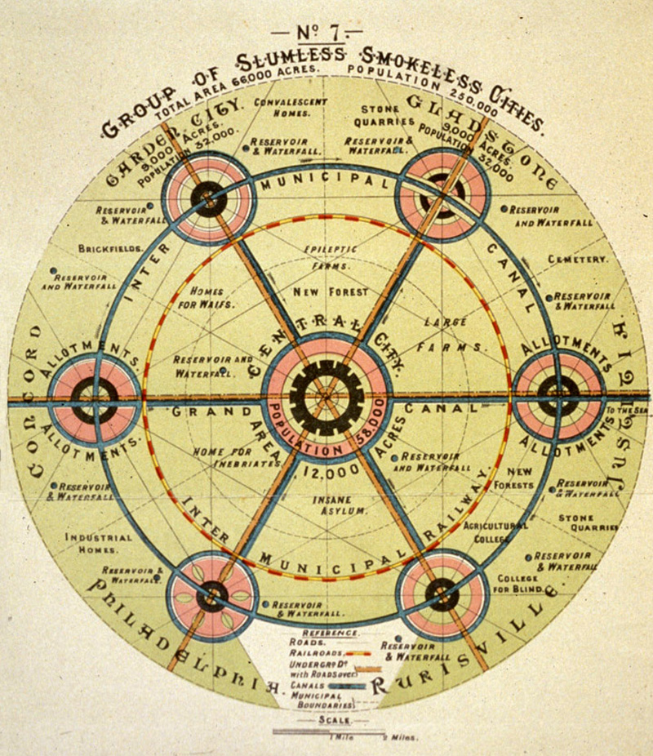
Plato
Republic, 380 BCE
Thomas More,
Utopia, 1516
Ebenezer Howard,
Garden Cities of To-Morrow, 1902
Utopia

Slide 31
Utopia = ‘Good place’ or ‘No place’
from Greek eu, good + topos
or ou, no + topos
Sitopia = ‘Food place’
from Greek sitos, food + topos, place

Slide 32
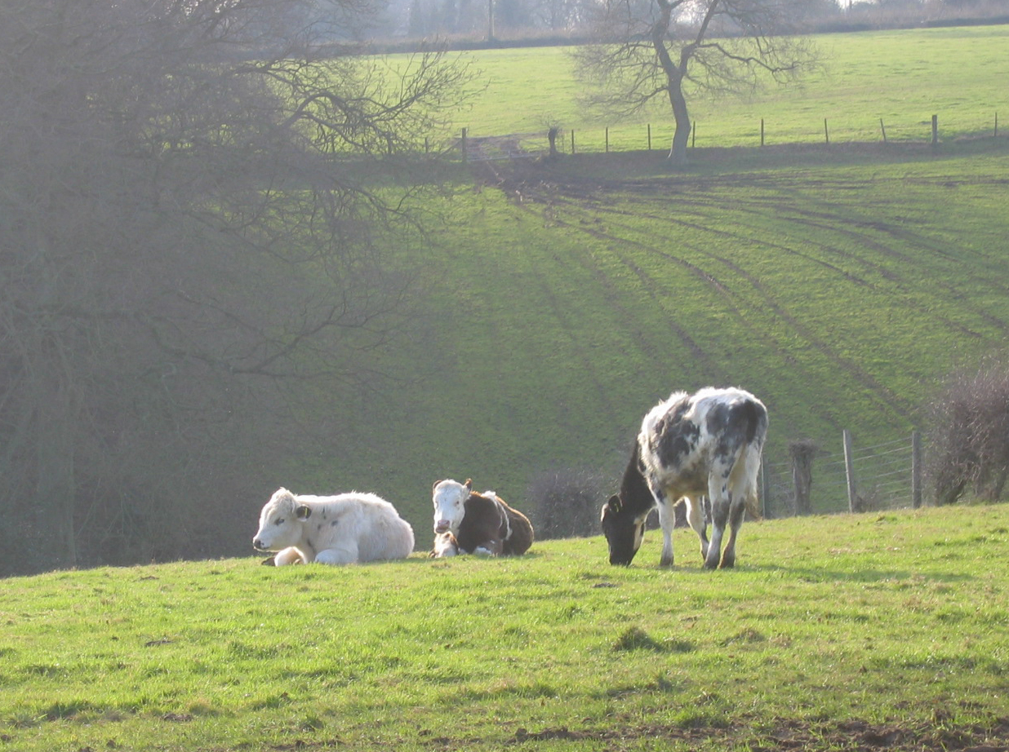
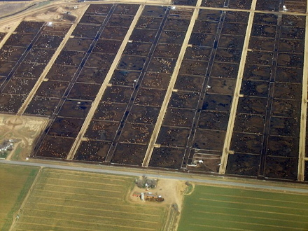
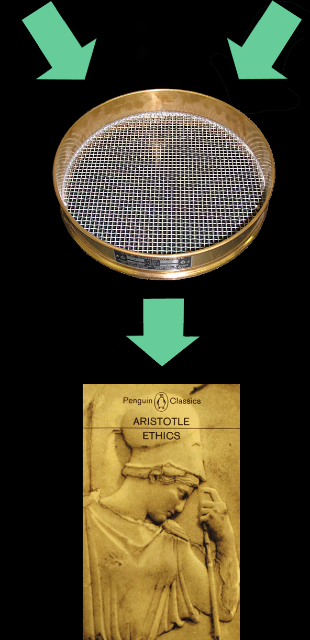
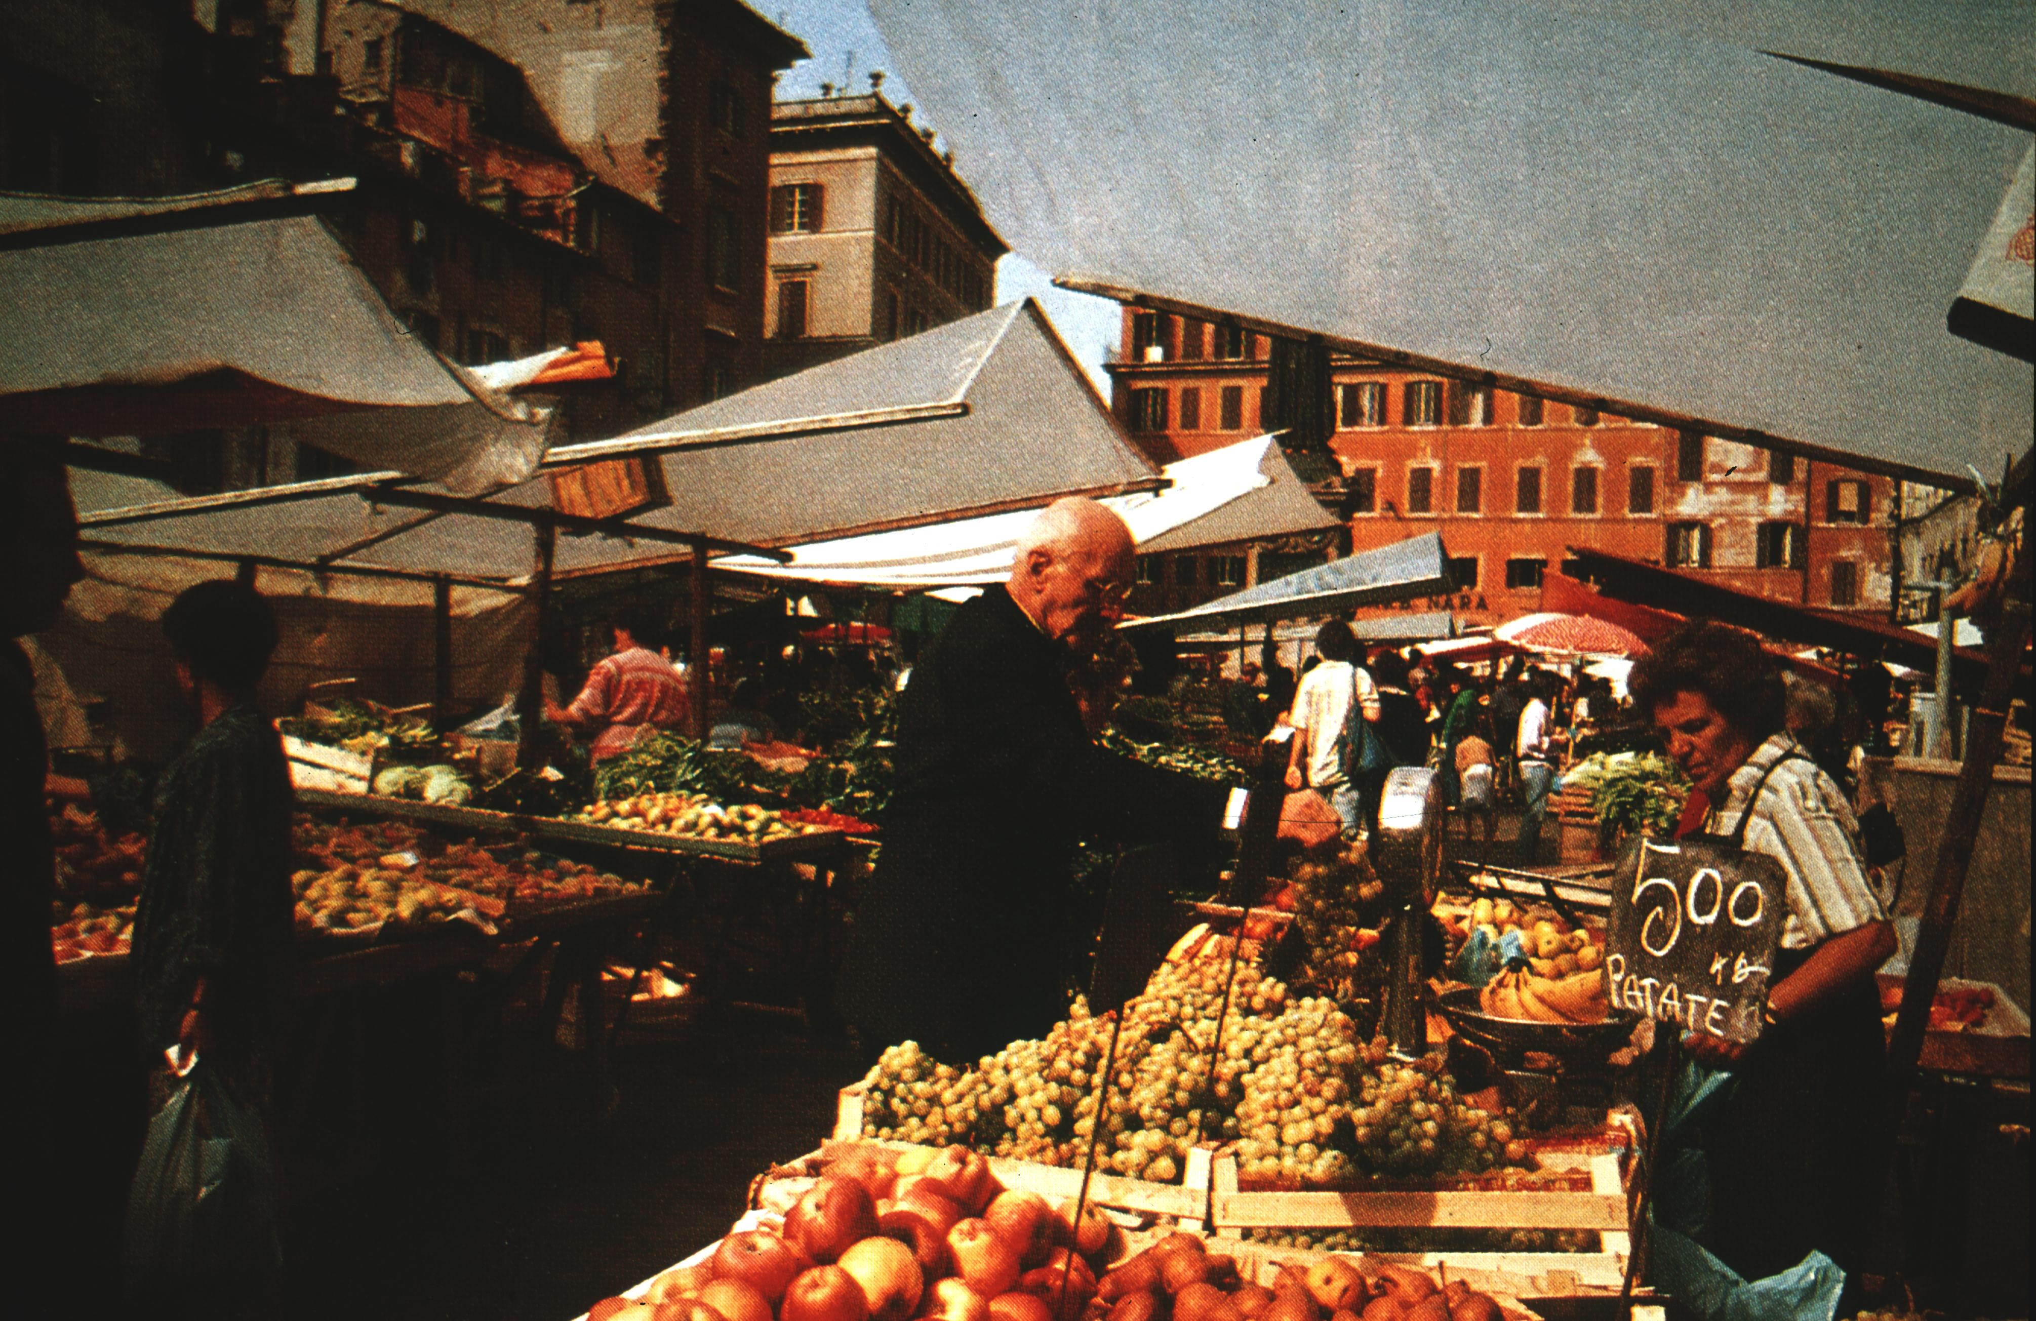






?
Slow
Fast
A good life?

Slide 33




New Delhi, 2020
Amazon, 2020
Bangkok, 2020
UK, 2020
Fragility

Slide 34




Neighbourliness
Home cooking
Networks
Growing (some of) your own
Resilience

Slide 35

Seeing through food

Slide 36



London, 1940
Havana, 2010
Detroit, 2015
Food is life

Slide 37




Identity

Slide 38




Wakulima Market, Nairobi
CSA – Angelic Organics, Chicago
Malasian rice farmers
Food court, Singapore
Community

Slide 39


Power

Slide 40

A good society

Slide 41

carolynsteel.com

